Slide 1
Titleist Golf Project
Stat 795 Final Project
Aditya, Josh, Kelso

Slide 2
Outline
e Introduction/Methods
e Design of Experiment
e Model Selection/Diagnostics e Results
e Conclusion

Slide 3
Introduction
Problem
Titleist is suing a small business that is refurbishing used Titleist golf balls and selling them as new.
The company claims that since the balls are practically new that there is no difference in performance between new Titleist balls and the refurbished ones.

Slide 4
Design of Experiment
Prostatic capsule penetration is an important indicator
10-year survival rate of patients with tumor-free capsule in 1995: 79%
10-year survival rate of patients with capsule penetration: 58%

Slide 5
Data Set
Ohio State University Comprehensive Cancer Center
380 Observations of subjects with preliminary signs of abnormal prostate function
No longitudinal data on subjects

Slide 6
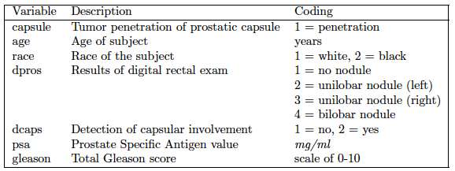
Variable Descriptions
Description of Variables

Slide 7
Exploratory Data Analysis
Categorical Predictors

Slide 8
Exploratory Data Analysis
Categorical Predictors

Slide 9
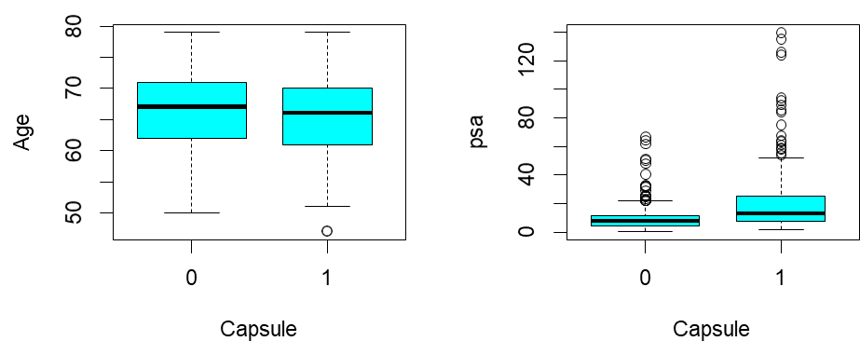
Exploratory Data Analysis
Continuous Predictors
2-sample T-test for difference between means of two groups
Positive relationship between PSA value and tumor penetration
Cohen’s D used to corroborate data
Age was of negligible effect
PSA was of moderate effect

Slide 10
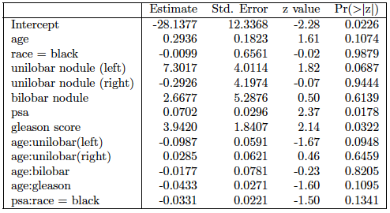
Model Selection
Reduced Model after Backward Selection

Slide 11
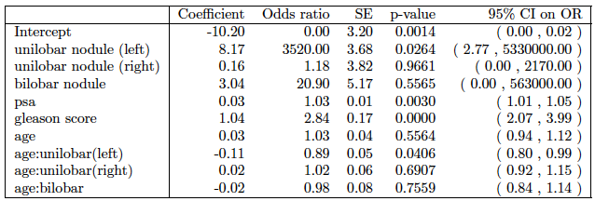
Model Selection
Interaction Model (Candidate 1)

Slide 12
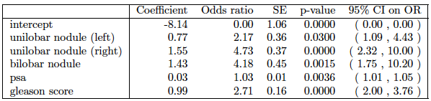
Model Selection
Reduced Model (Candidate 2)

Slide 13
Model Selection
Reduced Model
Two candidate reduced models done by stepwise model selection with AIC and p-value analysis, respectively
ANOVA shows that both models are significantly different from full model, but not significantly different from each other
Final reduced model without interaction terms

Slide 14
Model Diagnostics
For the model diagnostic analysis, PSA was converted to a categorical variable by binning the values into 8 categories.
Graphs of measures of influence depicted potential outliers.
None of these outliers displayed multiple measures of influence outside of their respectable cutoffs. Therefore, no data were removed.
Interpretation of the final model requires consideration of the odds ratios for each predictor in relation to detection of capsular penetration.

Slide 15
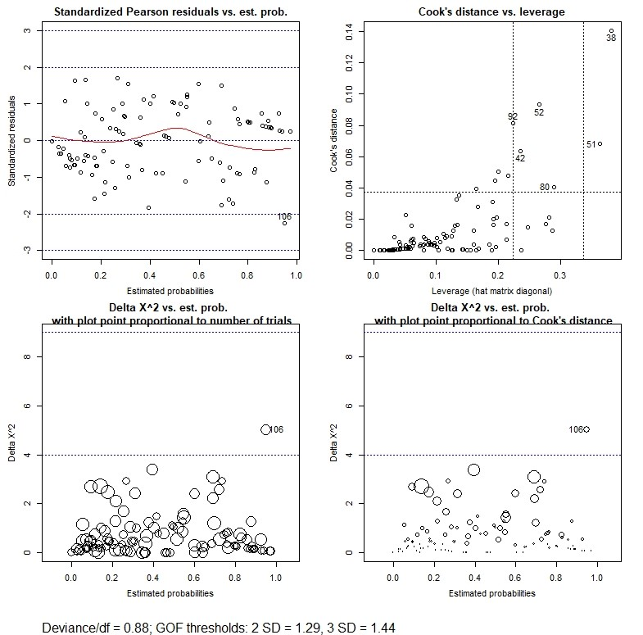
Model Diagnostics

Slide 16
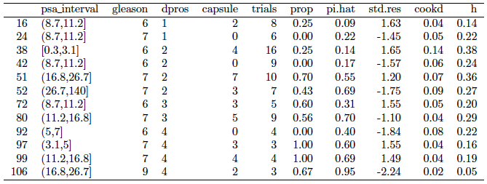
Model Diagnostics

Slide 17
Inferences
Odds ratio for each predictor is calculated by transforming the respective coefficient estimates by e^{β}

Slide 18
Conclusion
Analysis of the final reduced model shows a sensitivity of 0.77 and specificity 0.78.
Higher sensitivity is preferred over specificity, in this case.
Verifies that model has highest chance of properly predicting capsular penetration based on baseline diagnostic measurements.
Limitations:
Sample size limits ability to improve variability of model
Other important variables (i.e. diet, exercise, smoking, etc.) would help improve the model

Slide 19
References
e “SEER Cancer Fact Sheet: Prostate Cancer”. NIH. https://seer.cancer.gov/statfacts/html/prost.html. Retrieved 13
November 2018.
e “Prostate Cancer Treatment”. National Cancer Institute. https://www.cancer.gov/types/
prostate/patient/prostate-treatment. Retrieved 13 November
2018.
e Ruddon, Raymond W. (2007). Cancer biology (4th ed.). Oxford: Oxford University Press. p. 223. ISBN 9780195175431.
e Clinical and pathological significance of the level and extent of
capsular invasion in clinical stage T1–2 prostate cancer. TM Wheeler, O Dillioglugil, MW Kattan, A Arakawa. - Human pathology, 1998.
e “Interpreting Diagnostic Tests”.
http://gim.unmc.edu/dxtests/roc3.htm. Tape, Thomas G. MD. University of Nebraska Medical Center. Retrieved 13 November 2018.

